Slide 1
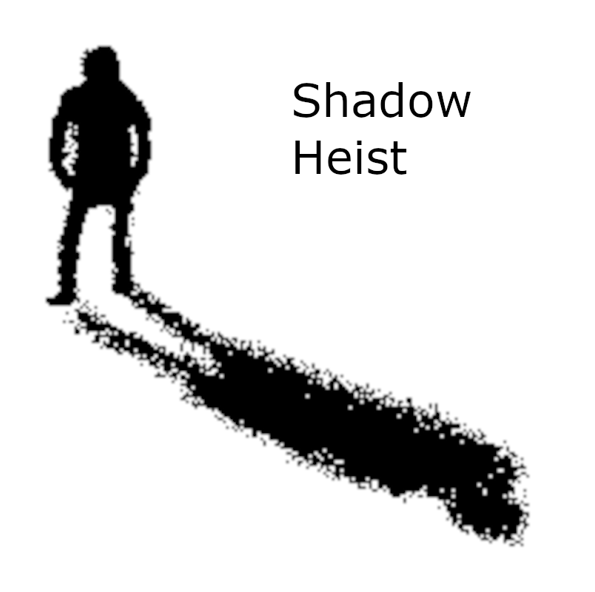
Shadow Heist
“Hide. Steal. Escape.”
Sabir Nour Abderrahmane • Pannu, Pamjot Singh • Le, Ngoc Thanh
Game Programming 1
Shadow Heist
Game Programming 1
01

Slide 2
Game Overview
Play as a thief breaking into a rich man’s mansion.
Explore maze-like rooms, collect keys, and discover the safe code. Avoid guards while planning each move carefully.
Win by opening the safe without getting caught.
Genre
Stealth • Strategy • Puzzle
Target audience
Everyone
Main objective
Steal the safe and escape.
Shadow Heist
Game Programming 1
02

Slide 3
Core Mechanics
The game meets the requirement for at least two core mechanics.
Player Stealth Movement
• Move with WASD
• Hold Shift to run
• Navigate around walls
Key + Safe Puzzle
• Collect keys
• Find or unlock the safe code
• Advance to the next level
Guard Obstacle
• Fixed patrol routes
• Forces timing and planning
• Avoid detection
Shadow Heist
Game Programming 1
03

Slide 4
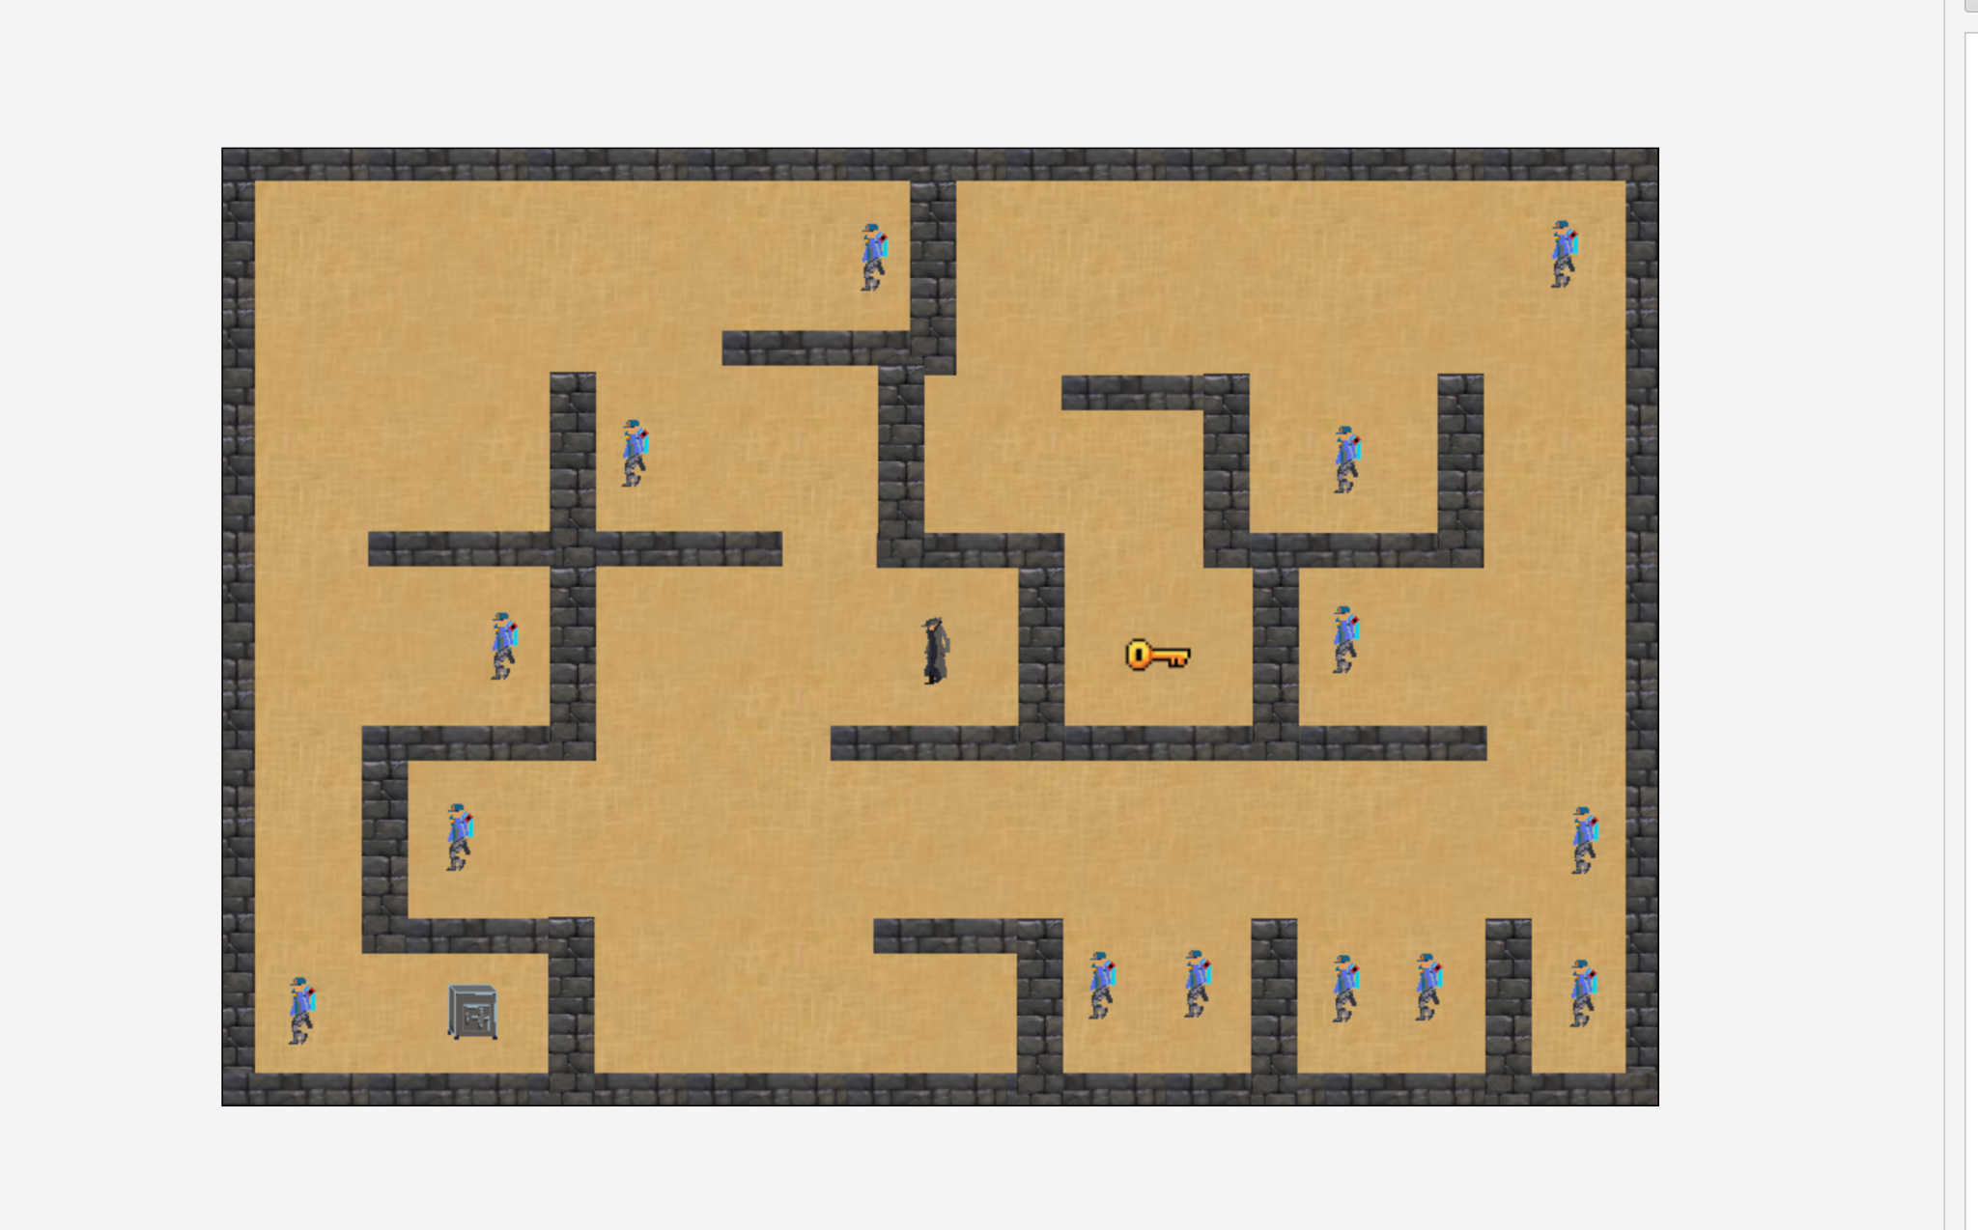
Game World & Levels
Level goal
Reach the key, locate the safe, and avoid detection.
Setting
A rich man’s mansion designed as a maze filled with guards, locked paths, keys, and clues.
Progression
Each level can add more guards, tighter paths, and more difficult timing.
Shadow Heist
Game Programming 1
04

Slide 5
Controls & User Interface
Controls
• W — move up
• A — move left
• S — move down
• D — move right
• Shift + WASD — run
User Interface
• Start menu: Play, Credits, Tutorial
• Tutorial explains movement and objective
• Credits screen shows team and media sources
• In-game UI should show key/safe progress
Shadow Heist
Game Programming 1
05

Slide 6
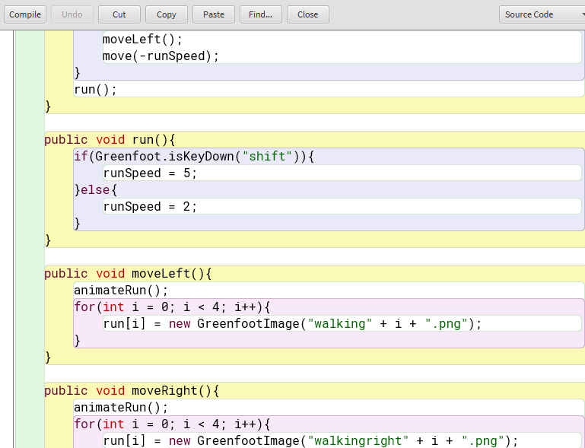
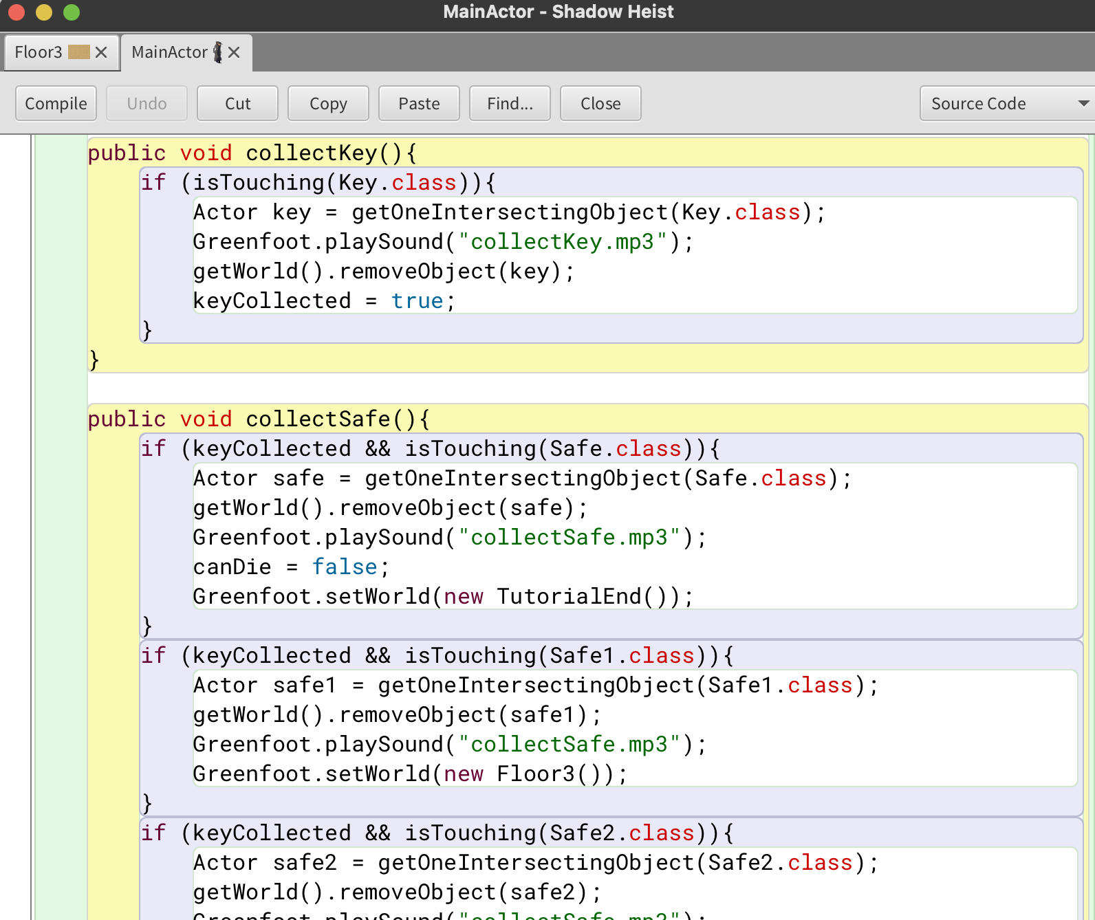
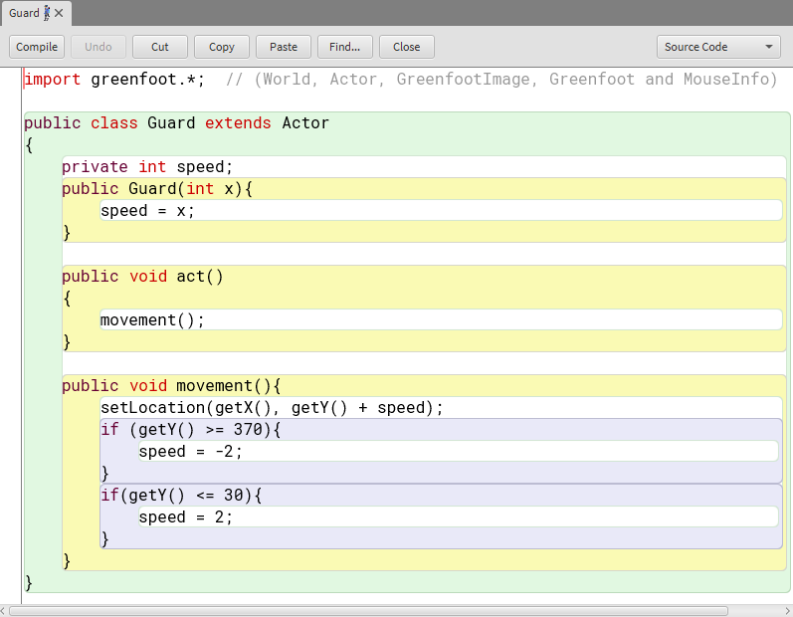
Main Greenfoot Code
The Player code handles movement, running, collisions, keys, and the safe. The Guard code controls patrols.
Shadow Heist
Game Programming 1
06

Slide 7
Team Member Contributions
Nour
• Actor movement code
• Next-level system
• Interactive buttons
Nicolas
• Menu screen
• Wall collision system
• Game screen flow
Pam
• Majority of pixel art
• Playable character movement support
• Visual style consistency
Shadow Heist
Game Programming 1
07

Slide 8
Challenges & Learnings
Challenges Faced
• Bugs froze the game while testing
• Time management made it hard to finish every feature
• Communication was not always clear
• Some mechanics were simplified to meet the deadline
What We Learned
• Test code in small parts
• Communicating as a group improves work
• Keep backup versions before major changes
• Simple mechanics can still be fun when feedback is clear
Shadow Heist
Game Programming 1
08

Slide 9
Future Enhancements
Possible improvements
• Add more levels with different and harder maze layouts
• Improve animations for walking, running, and getting caught
• Add a save system so players can continue from their progress
• Create more enemy types, such as lasers or cameras
• Improve difficulty progression, sound effects, background music, and enemy behavior
Shadow Heist
Game Programming 1
09

Slide 10
References & Credits
Original pixel art: Pam
Greenfoot code: team implementation by Nour, Nicolas, and Pam
External media/font
Fontspace Calligraphy font: https://www.fontspace.com/calligraphy-font-f29723
Presentation template/design: Slidesgo, with icons by Flaticon and images/resources by Freepik
Game Soundtrack: https://youtu.be/9sprJQeh6Ik?list=PLyuakwzSUr6D7h_jiWkOI1KCDctEp1iA6
Win sound effect: https://youtu.be/rr5CMS2GtCY
House thief's Illustration: https://freerangestock.com/photos/120449/house-thief-s-.html
Winning Music: https://www.youtube.com/watch?v=Ufsk_uKLFwo
Shadow Heist
Game Programming 1
10

